Slide 1
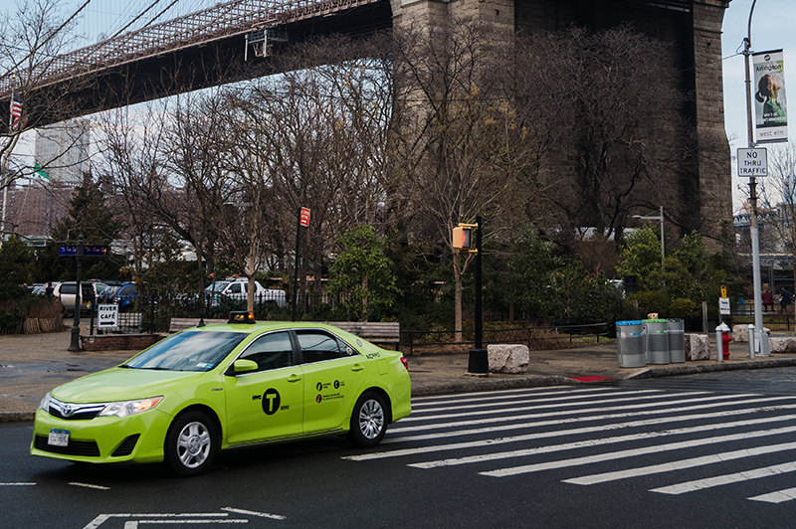
NYC Taxi Analysis
By
Sravan Kumar Mangalagiri
Sai Sisira Pathakamuri

Slide 2
Outline
Project Overview
Analysis Approach
Dataset
Dataset description
Data Cleaning
QUESTIONS
Exploratory Data Analysis
Conclusion

Slide 3
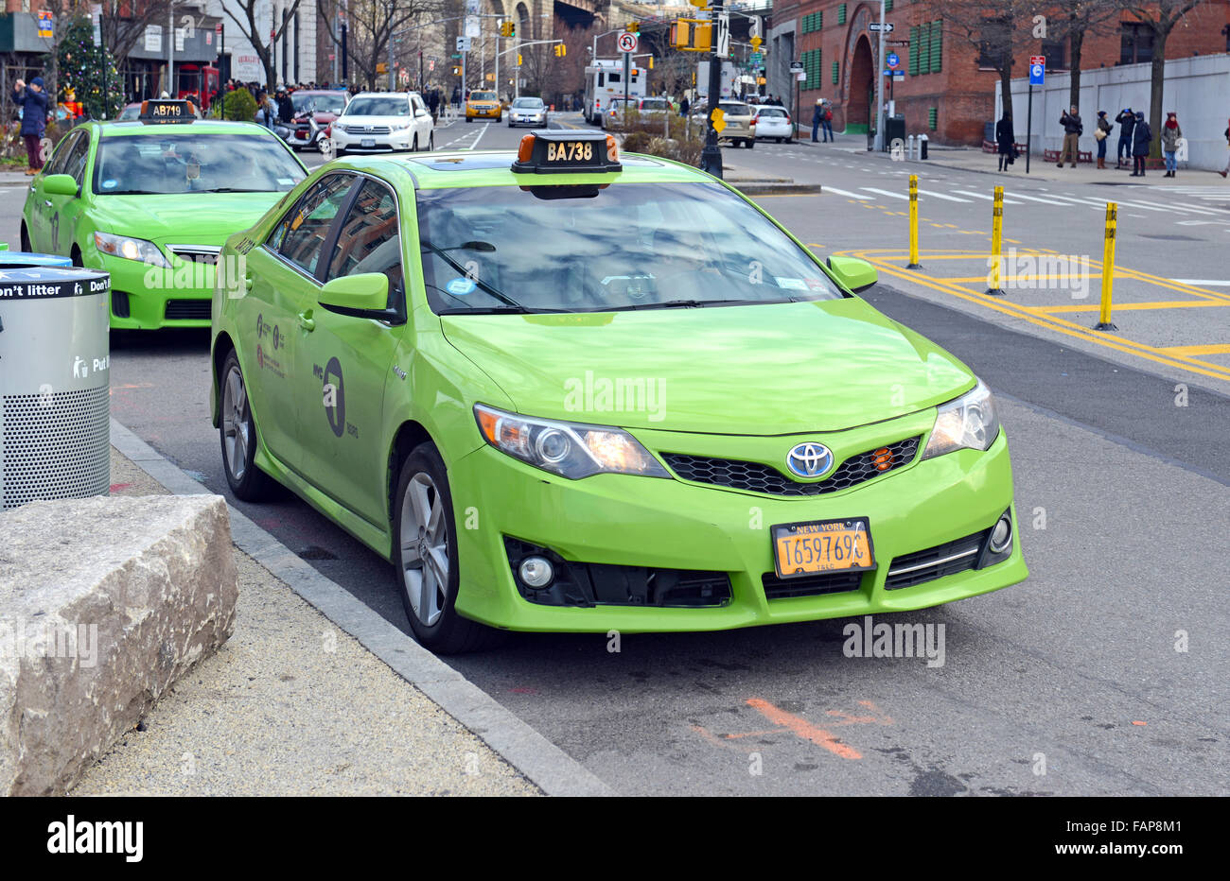
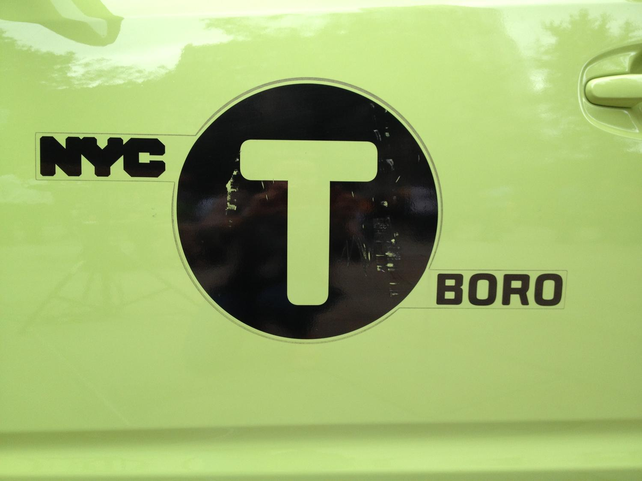
Project Overview:
Introduced in 2013, the green colour cabs can be hailed only in the outer boroughs (except at the airports) and in the northern part of Manhattan, specifically above 96th street on the east side and above 110th street on the west side.
Post six years of Green Taxi’s launch, It would be interesting to know how the Green performing based on Taxi Trip Records in New York before, during the month of January and August as most of the tourists and students arrive in those months for the year 2022.
Notes:
Green taxi NYC: Green cabs, are For-Hire Vehicles that are permitted to accept street-hails. Yellow cabs are the official, and iconic, taxis in NYC. Green cabs are new to the city, since 2013, and the program was created to serve areas of New York not commonly served by yellow medallion cabs. Yellow taxis swarm Manhattan. Go to Brooklyn or Queens, it is not likely you will see any yellow taxis.

Slide 4
Project Approach:
Objective
Understanding Data
Data Cleaning and Transformation
Exploratory Data Analysis
Data Visualization

Slide 5
Dataset Characteristics:
Number of Datasets: 3
Dataset observations:
Green Taxi January: 62495
Green Taxi August : 65929
Taxi Zones : 263

Slide 6
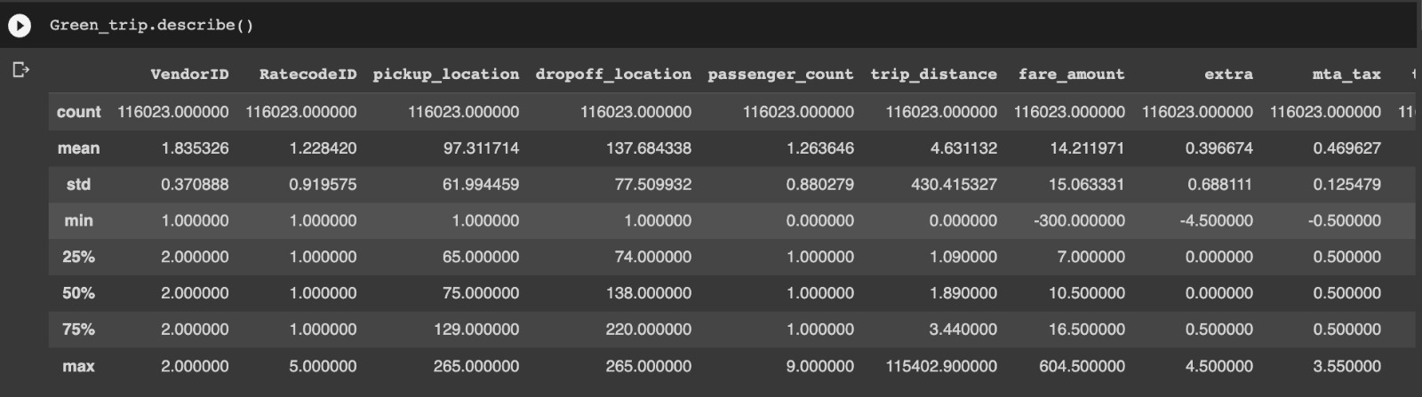
Data Characteristics:

Slide 7
QUESTIONS :
Research Questions:
1. Assess current trends in cash and cashless (Credit Card/Contactless) payments.
2. What characteristics influence passengers' decisions to share rides or go alone on weekdays and weekends? ,Daytime: between 9 a.m. and 5 p.m., or overnight ?
3. Annual patterns for group rides: to determine whether or not the travellers appreciate traveling in groups more. This analysis can help people comprehend the benefits of carpooling and raise their awareness of the pollution caused by vehicle emissions.
4. The volume of reservations for rides at various times of the week in various parts of New York City. And try to find out what influences a higher density of rides in a particular location at a certain time.
5. Provide images of taxi rides in various seasons like in Holidays.
6.What influences how much passengers tip the driver? based on the ride's route, drop-off location, tourism destination, and other factors.
7. Consider the time of day, the location, and how it influences the rate of ride booking when evaluating the ups and downs of surge prices.
8. Develop visualizations and perform a comparative analysis for each of the aforementioned study topics green cab.

Slide 8
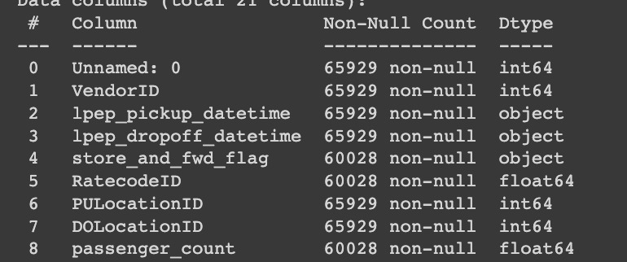
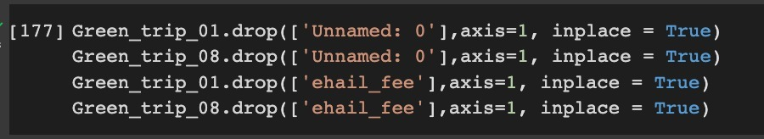
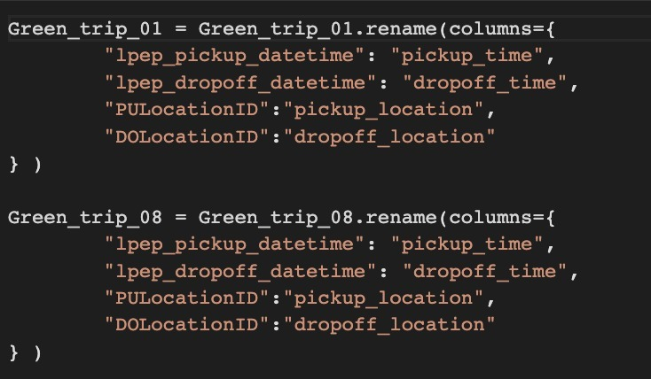
Data Cleaning:
Performed initial data analysis to check the data types of each column
Drop redundant columns
Rename columns as per data requirements
Merging all three datasets
Notes:
No Column of ehail in Yellow -> doesn’t take online ride bookings.

Slide 9
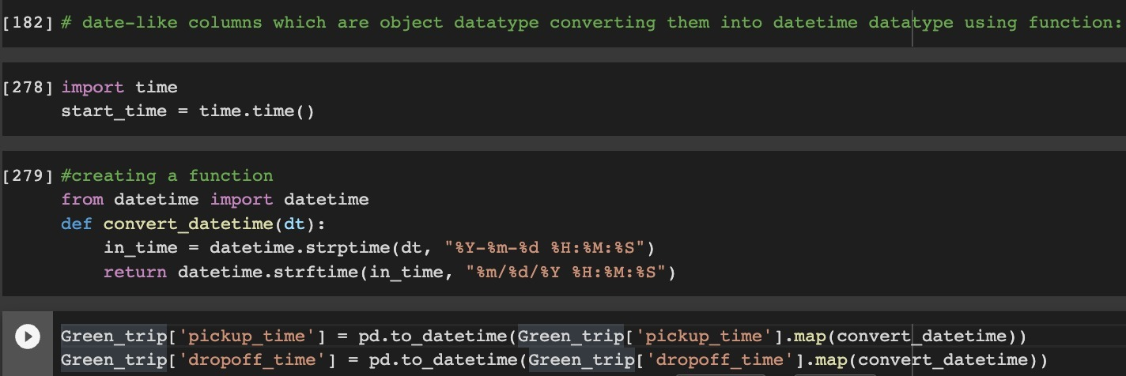
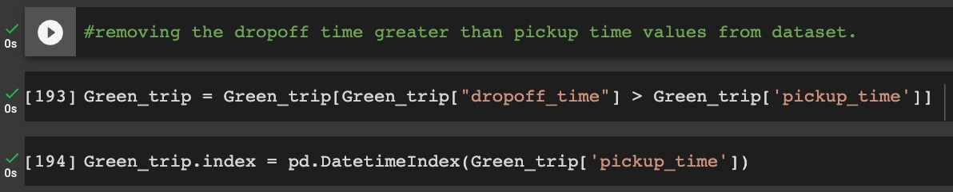
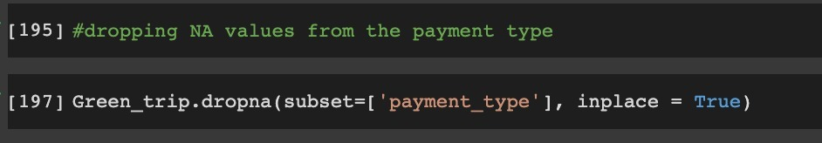
Data Cleaning :
Creating Functions to efficiently convert dates into datetime datatypes
Removing negative outliers by considering data where dropoff_time > pickup_time
Dropping NA values from payment type

Slide 10
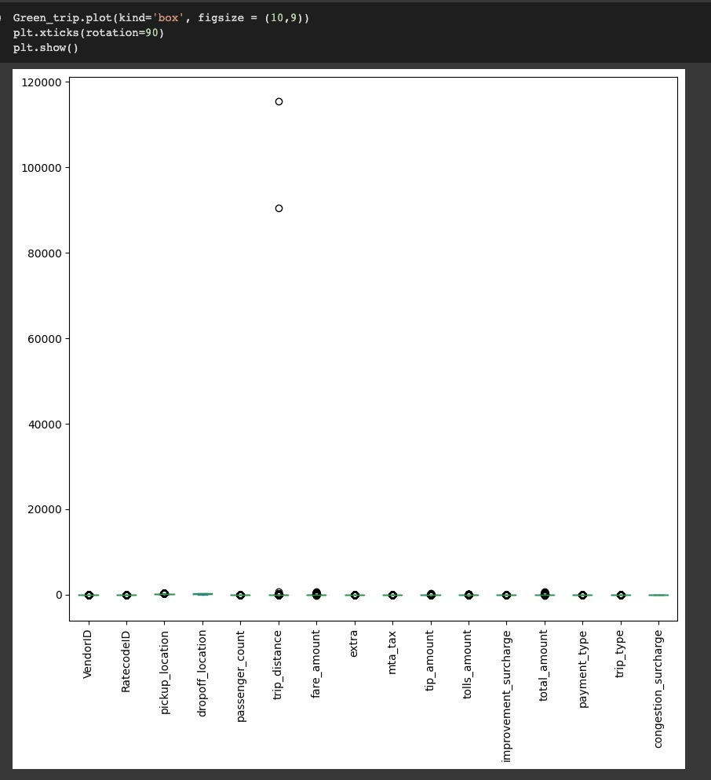
Data Cleaning:
Checking for outliers in the dataset.
We can clearly see that there are a few outliers here.
We could see the outliners for Trip distance, tip amount , total_amount, fare_amount

Slide 11
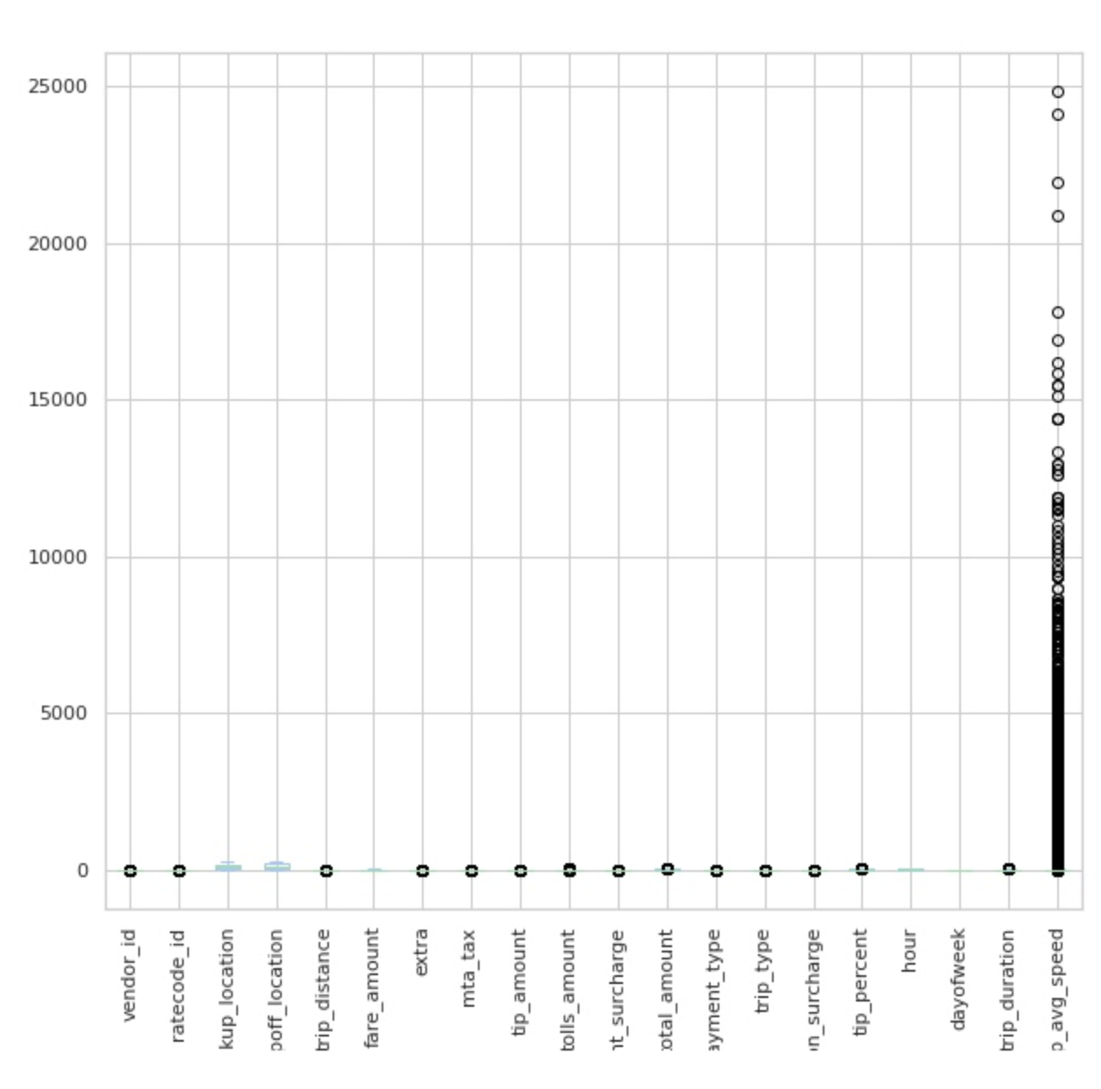
Data Cleaning :
Box plot of dataset after removing outliers

Slide 12
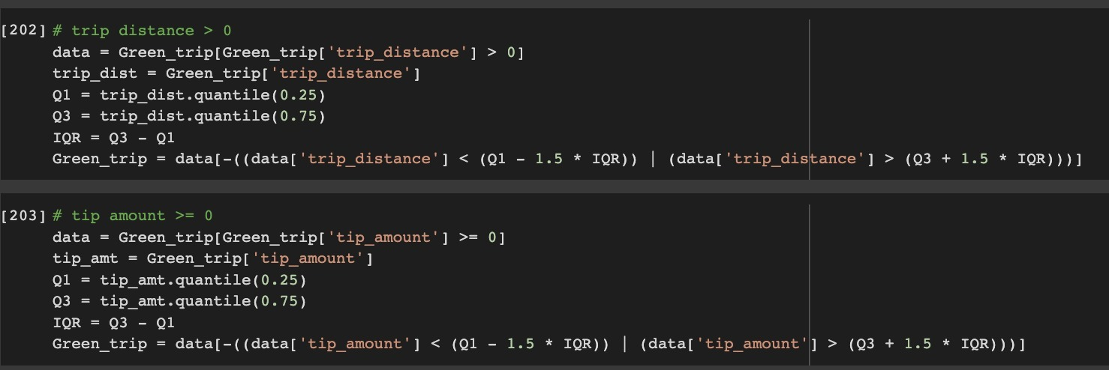
Data Cleaning: Removing outliers from dataset
For Trip distance, tip amount:
Checking if the trip distance and tip amount is more than 0.
Using Inter Quartile Range to remove outliers.

Slide 13
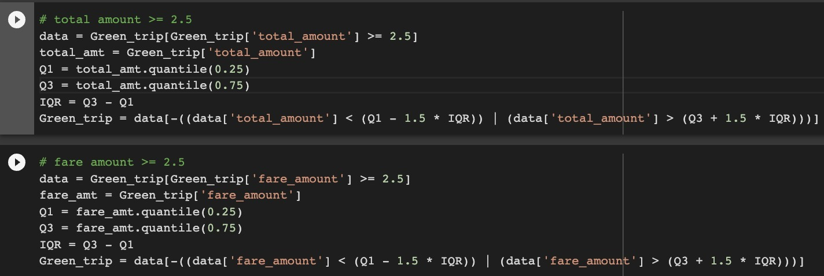
Data Cleaning: Removing outliers from dataset
For total_amount, fare_amount
Checking if total_amount and fare_amount is more than $2.5
Using InterQuartile Range to remove outliers

Slide 14
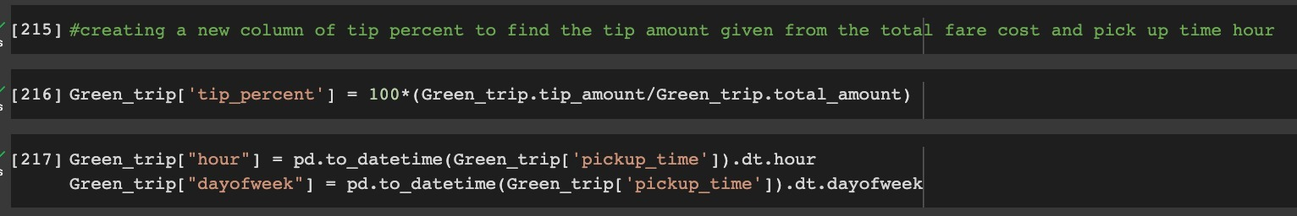
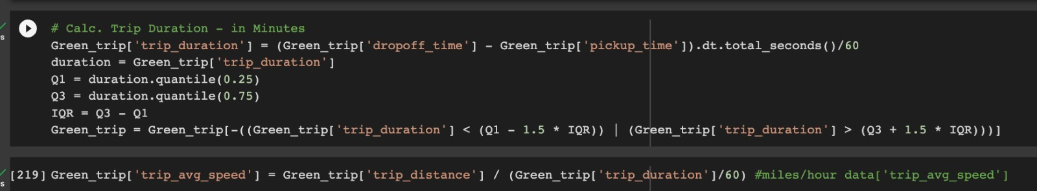
Data Cleaning:
Calculate tip percent based on tip_amount and total_amount and creating new columns based on data requirements
Calculate trip duration in minutes and average speed

Slide 15
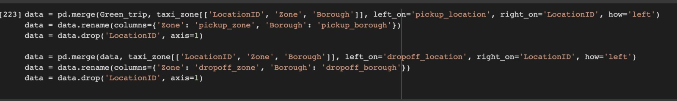
Data Cleaning:
Merging the green taxi dataset with the taxi zone dataset on the drop off location to find the congestion surge.

Slide 16
Exploratory Data Analysis

Slide 17
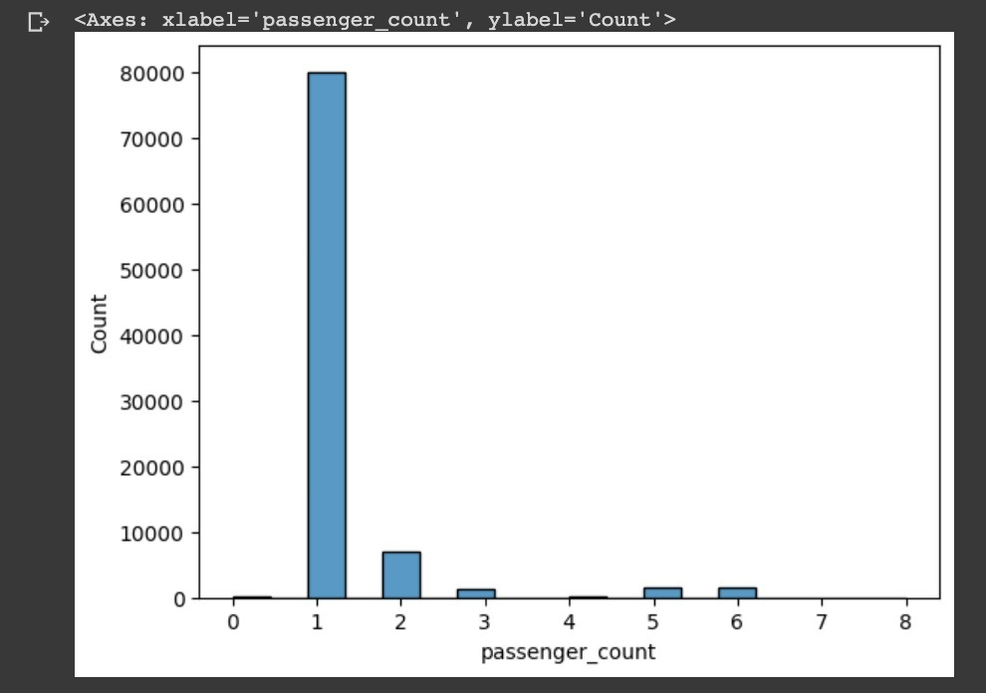
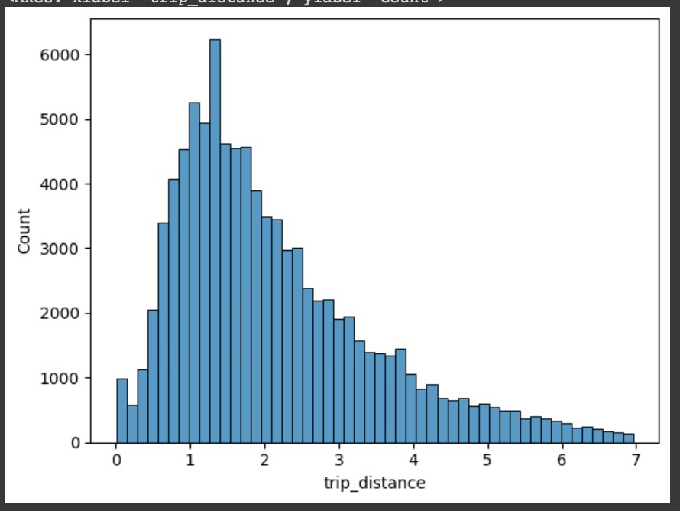
Analysis :
Distribution of data:
passenger_count : Right skewed
trip_distance : Right skewed
Notes:
This basically shows the awareness amongst people that they started avoiding travelling in cabs (social distancing) even before the lockdown was announced.

Slide 18
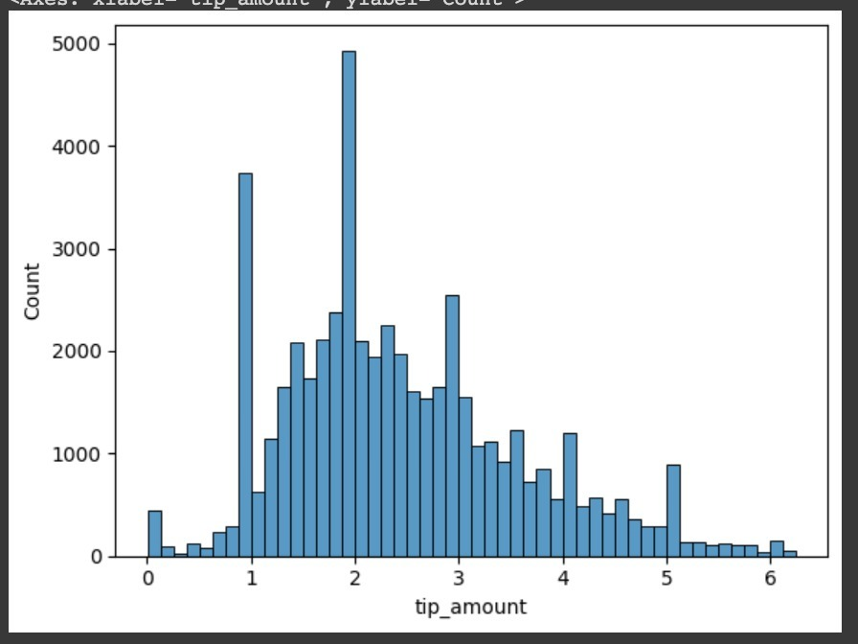
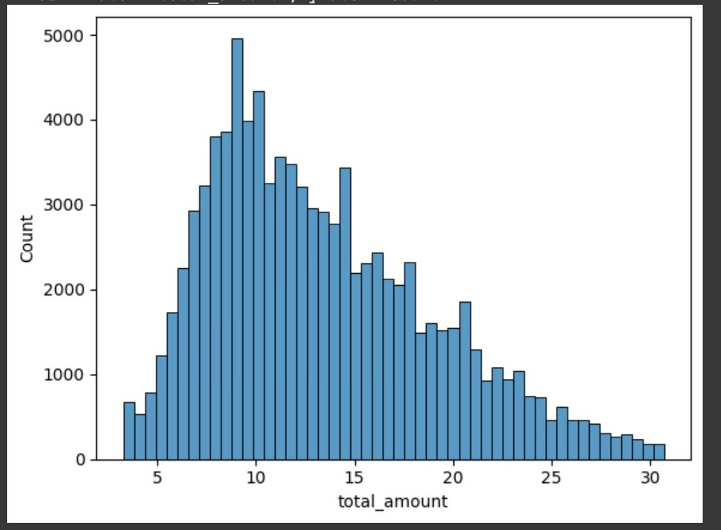
tip_amount : Normal distributed
total_amount : Right skewed

Slide 19
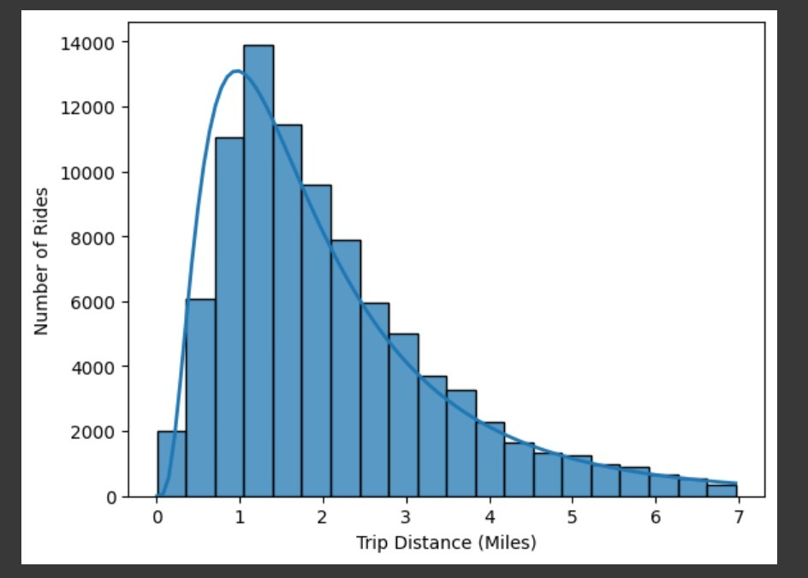
Trip distance vs number of rides:
Plotting the graph for trip distance vs number of rides.
Most of the rides are happening within 1-2 miles of range

Slide 20
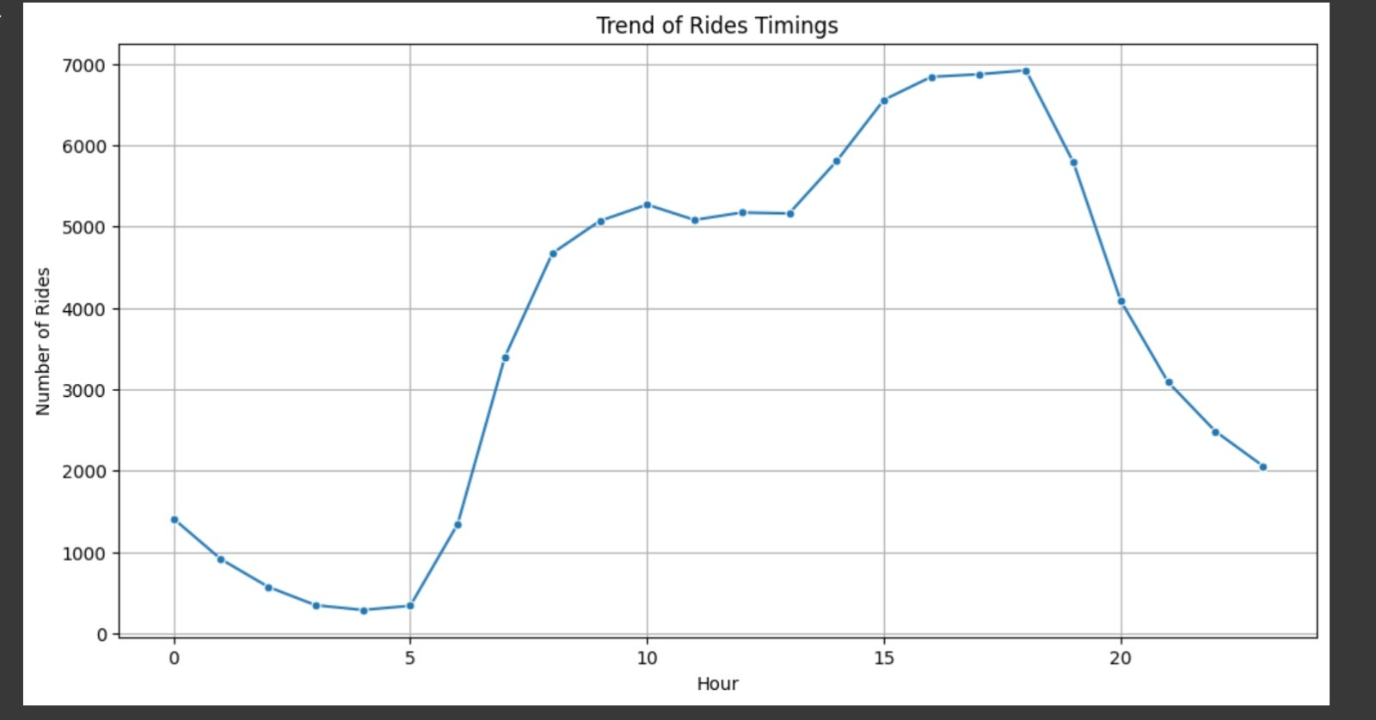
Hours vs number of rides:
Plotting the graph for hour vs rides.
Most of the rides are happening between the afternoon to evening (i.e 15-20).

Slide 21
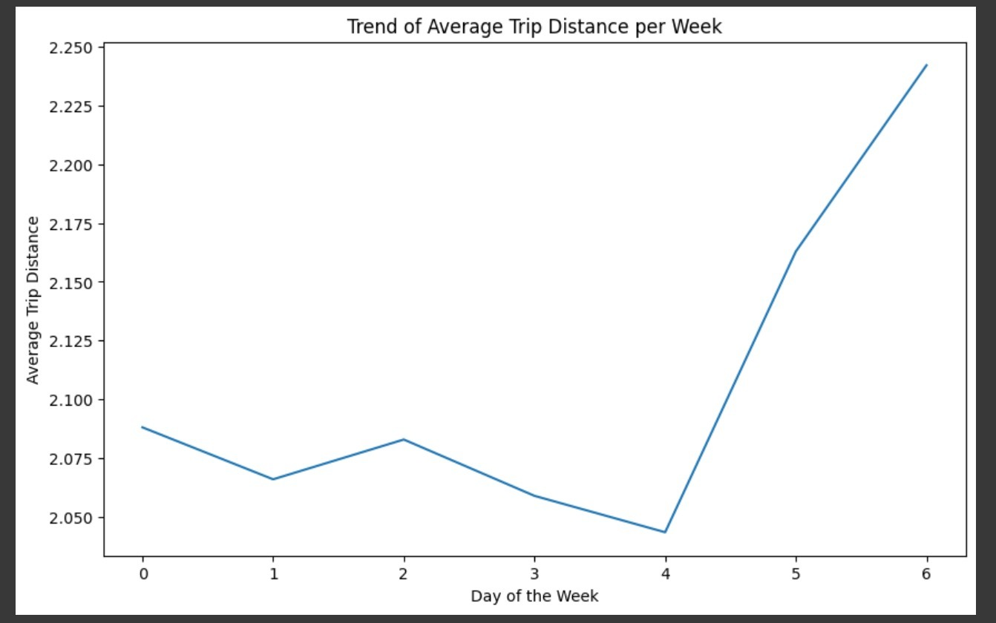
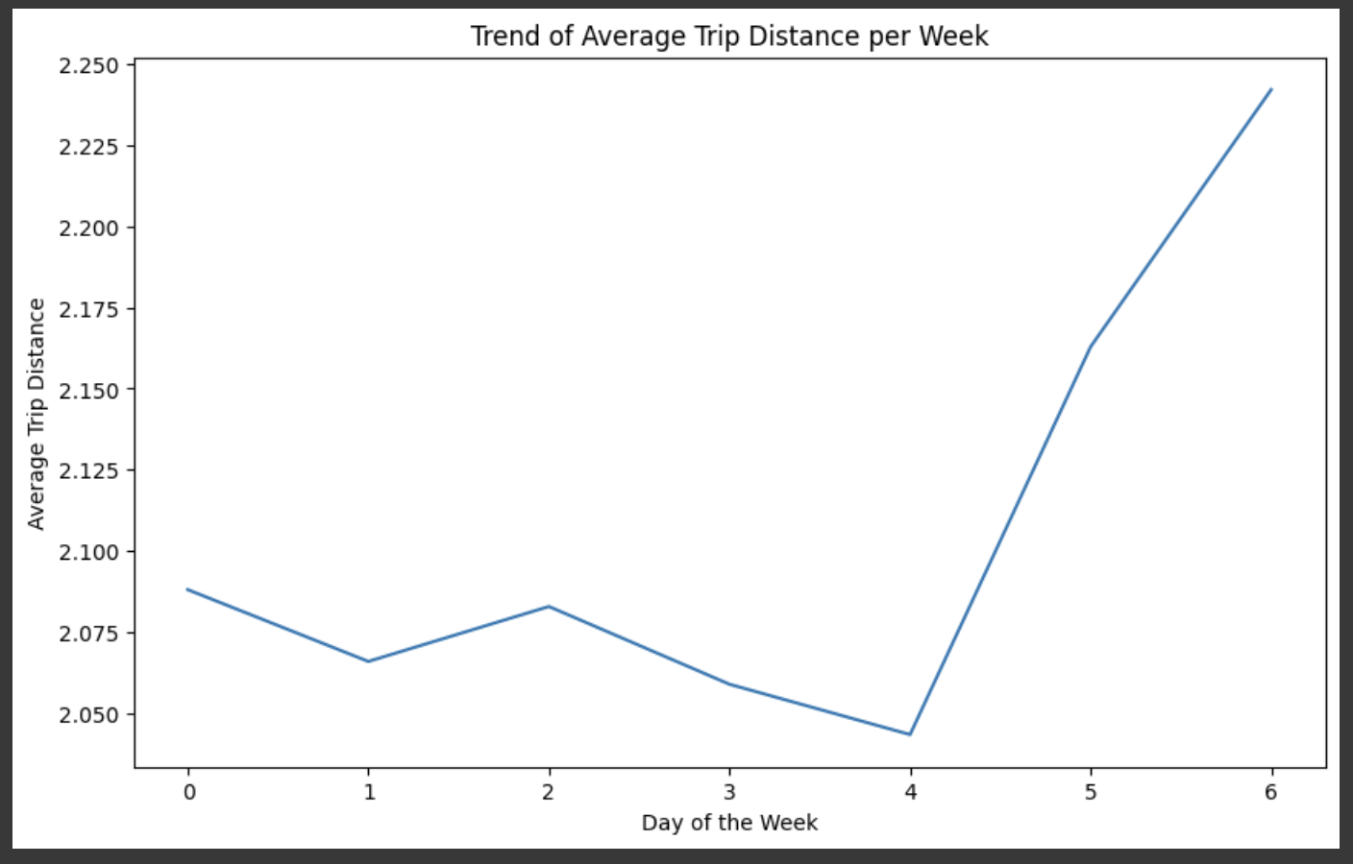
Trends :
Trend of the trip distance based on hour of day and
Trend of average trip distance based on days of the week.

Slide 22
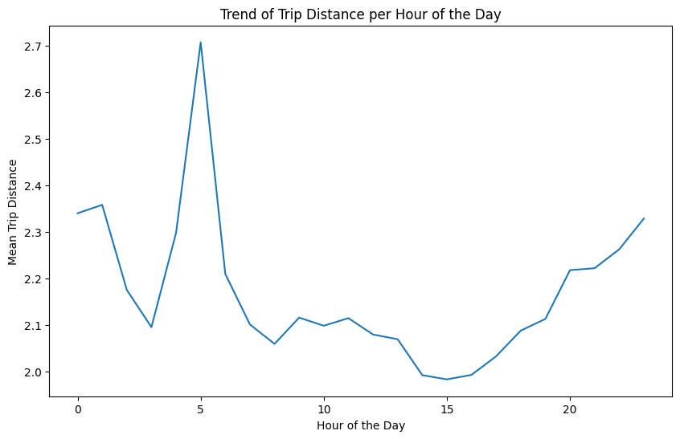
The percentage of the tip amount peaks on early morning after which there is a significant decrease as the hour days goes on and increase during the mid night.

Slide 23
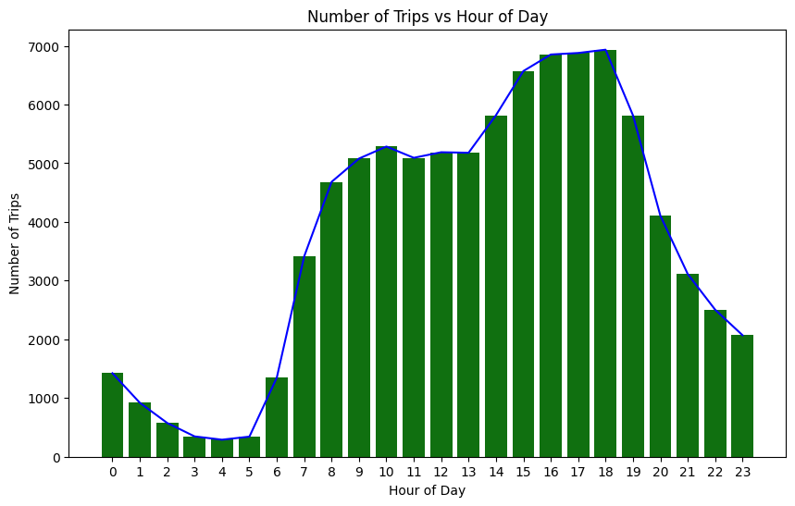
During the morning the number trips are low but in the evening the number of trips reaches it peaks, where the drivers can find the customers with easy.

Slide 24
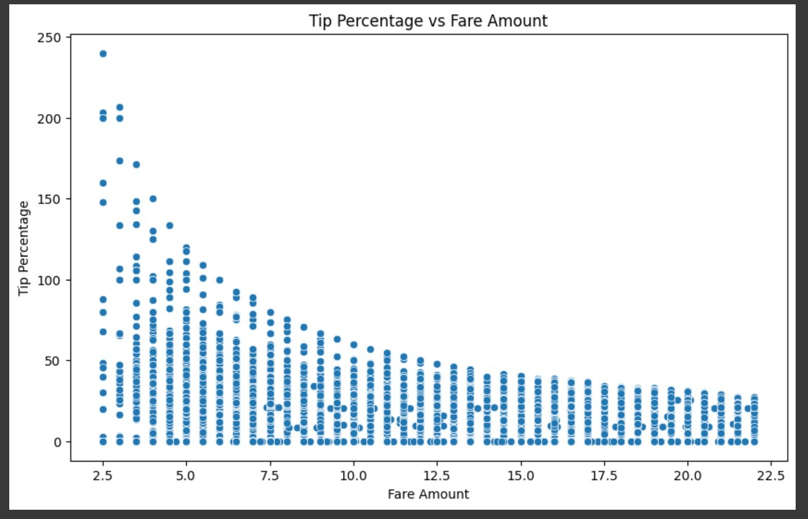
The percentage of the tip amount goes on decreasing as the Fare amount of the trip ride increases.

Slide 25
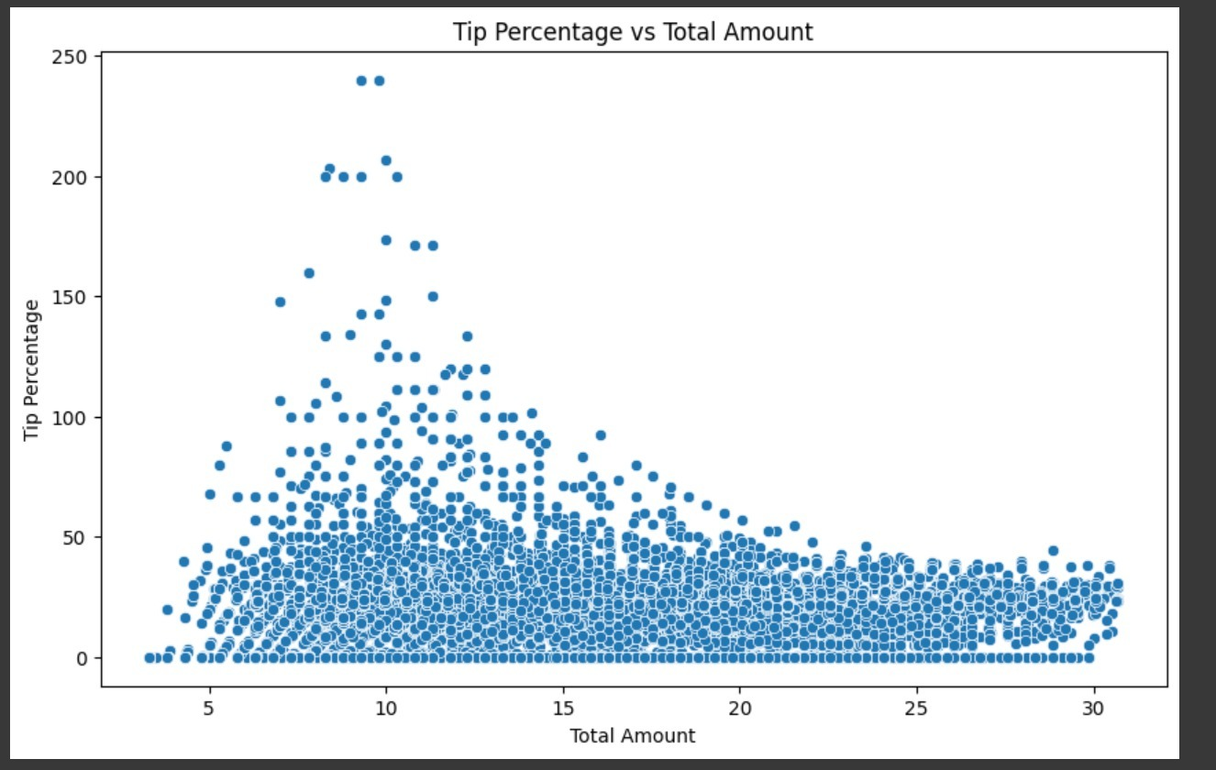
When the total amount is between 5-15$, the trip percentage has its peaks. The drivers has highest change of getting high tip percentage when the total amount is between 5-15$.

Slide 26
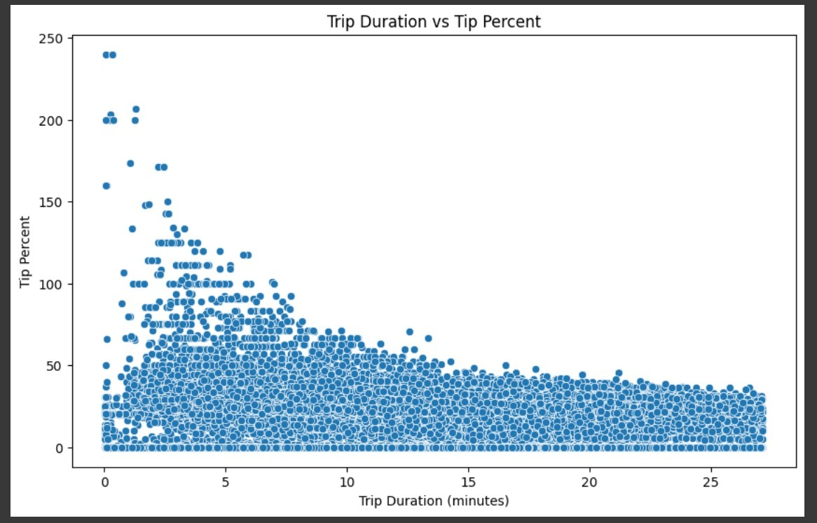
When the trip duration is between 0-5 minutes. The driver has higher chance of getting the tip percent.

Slide 27
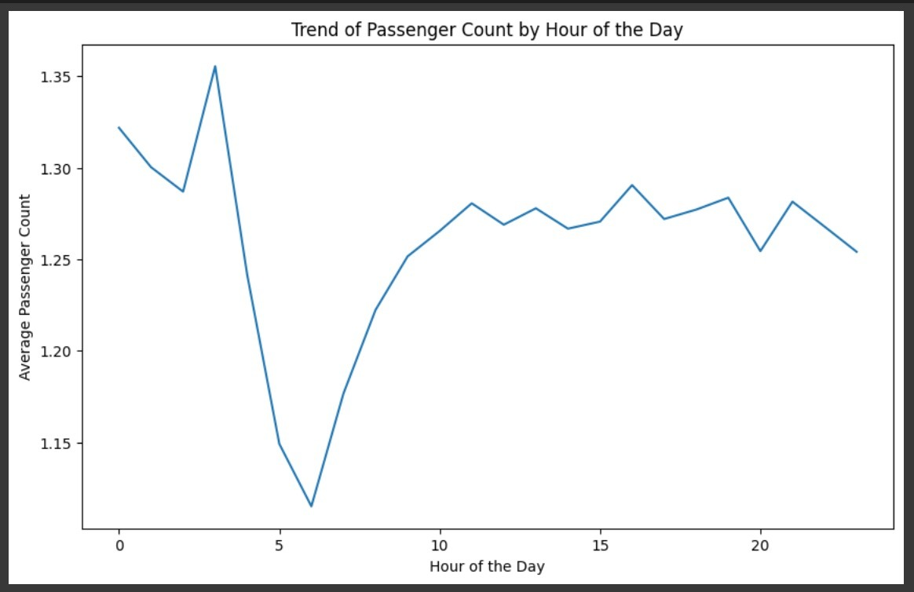
The average passenger counts is peaks at during early morning.

Slide 28
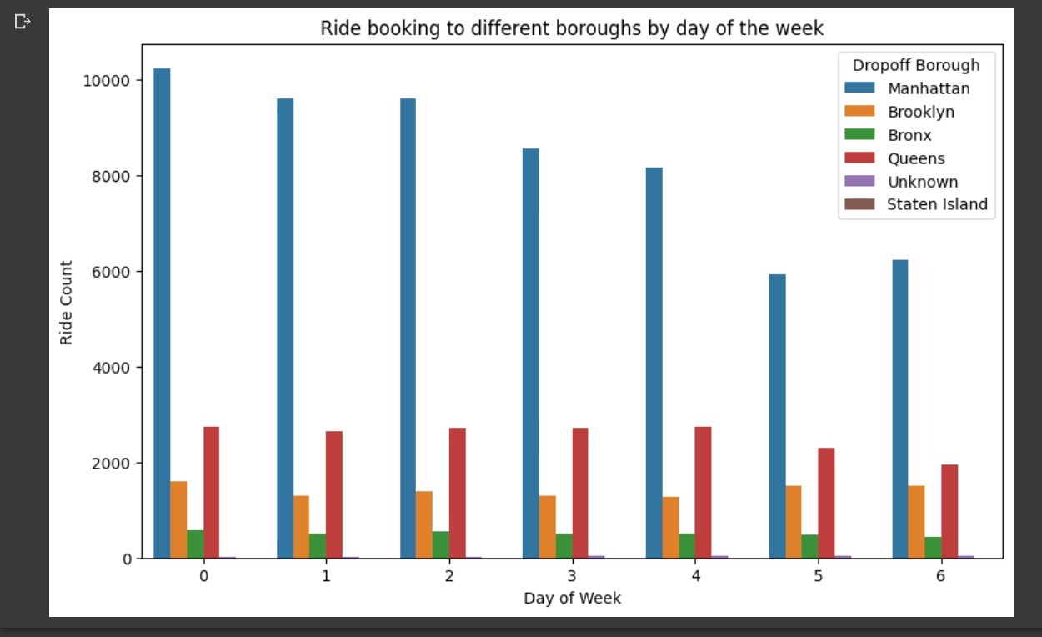
Analysis of ride bookings to different boroughs :
The borough that most people travel within or travel to in Green taxis is Manhattan followed by Queens, Brooklyn and Bronx.

Slide 29
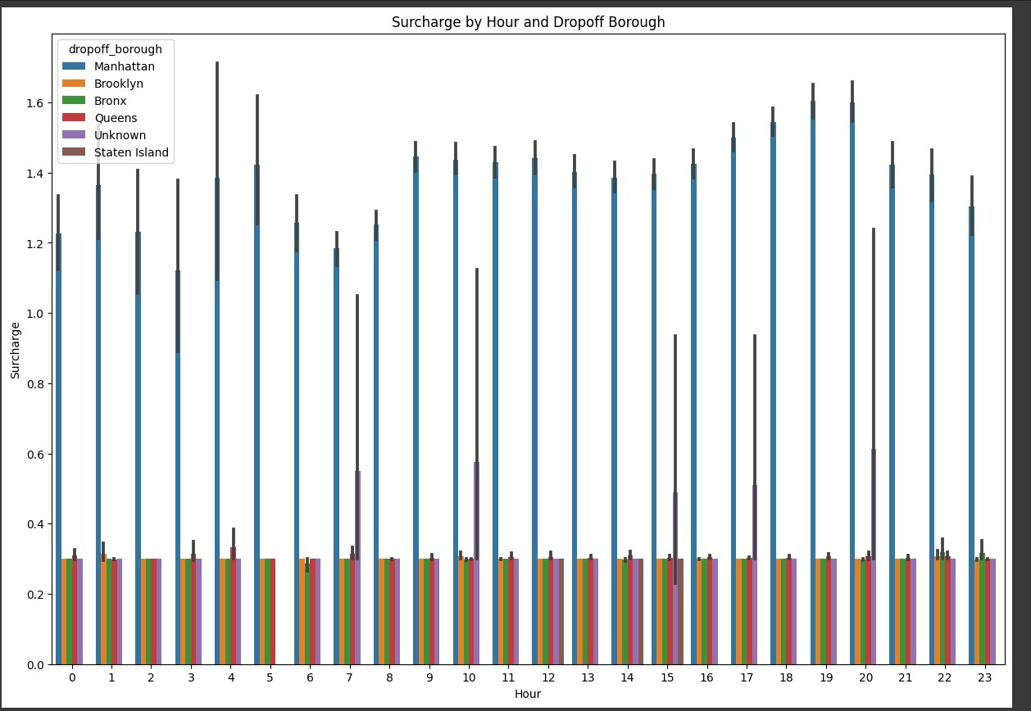
Finding the surcharge charge by hour based on area :
For Manhattan, the average surcharge is consistently greater than for any other Borough.
Early in the morning and again in the evening, the maximum surcharge amount is charged.

Slide 30
Conclusion :
From the analysis drivers can use this information to their advantage. Drivers who must be at their homes early in the morning for pick-up and at corporate locations in New York during business hours may find this analysis to be helpful. As a result, they would have the opportunity to get more rides, which would boost their income. With the help of this information, the TLC will be able to create a number of strategies to generate revenue from green taxis.

Slide 31
Thank You

